Slide 1



BAIUST Class Monitoring System
Author : Md. Shakhawat Hossain (1103047)
Supervisor : Jahid Arafat (Assistant Professor & Head of the Dept.)

Slide 2
BAIUST Class Monitoring System
Why?
BAIUST Class Monitoring System

Slide 3

BAIUST Class Monitoring System
Problem

Slide 4
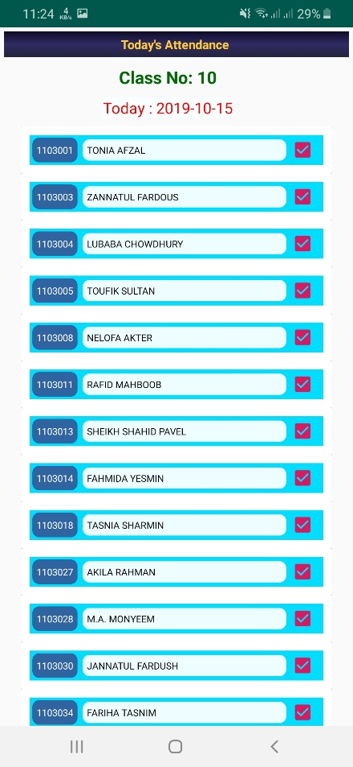
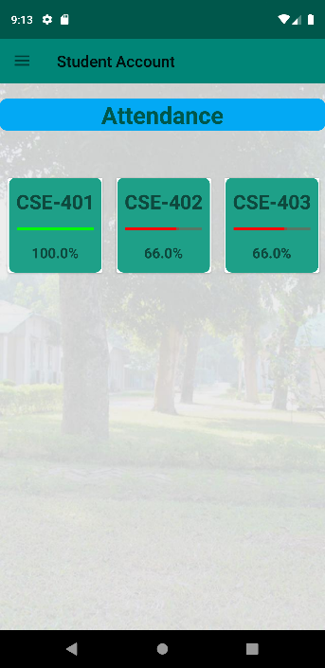
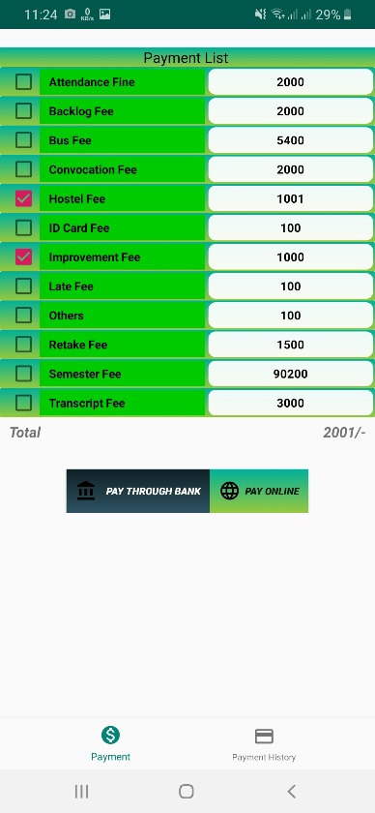
BAIUST Class Monitoring System
What is the Solution ?

Slide 5
BAIUST Class Monitoring System
Is this optimal solution for BAIUST?

Slide 6
Let’s Check . . .

Slide 7
Thank you

